Slide 1
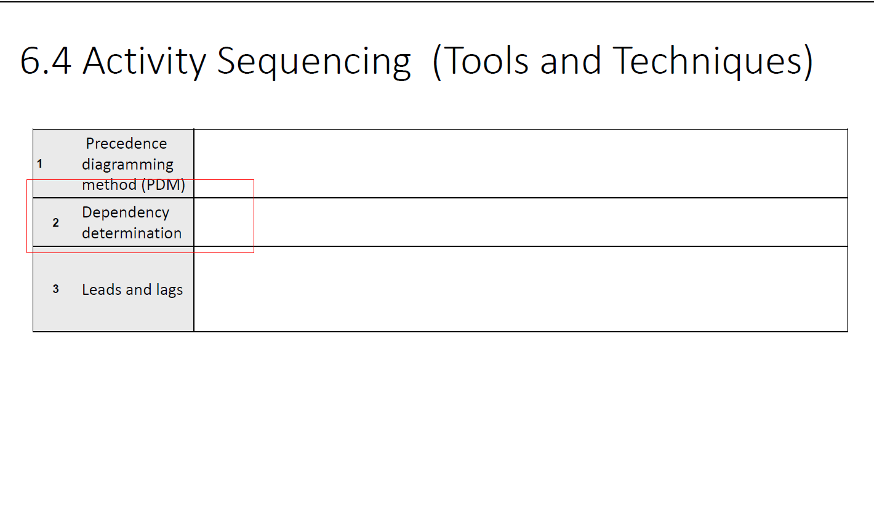

Slide 2


Slide 3


Slide 4
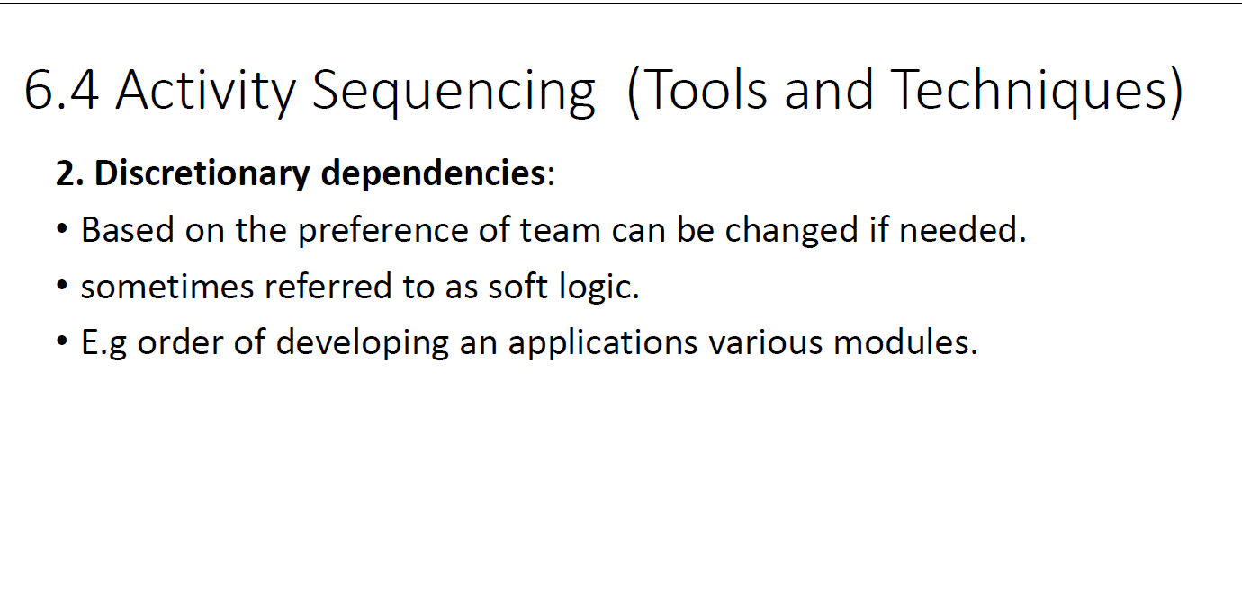

Slide 5


Slide 6


Slide 7
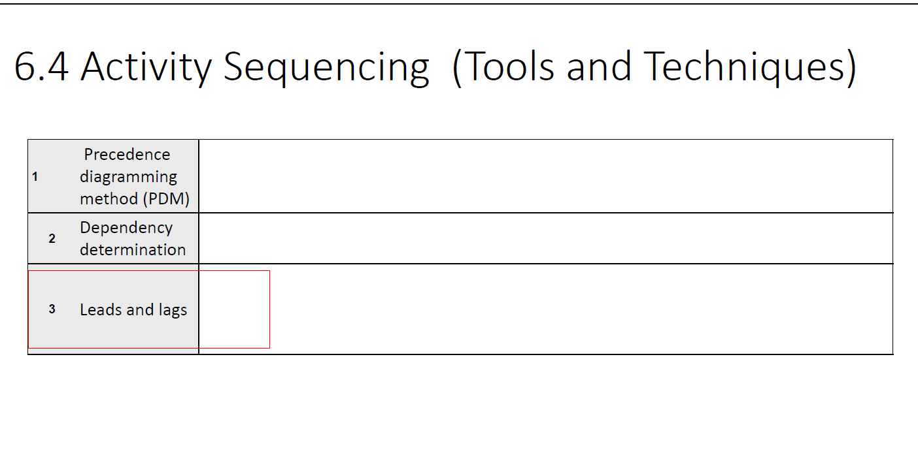

Slide 8
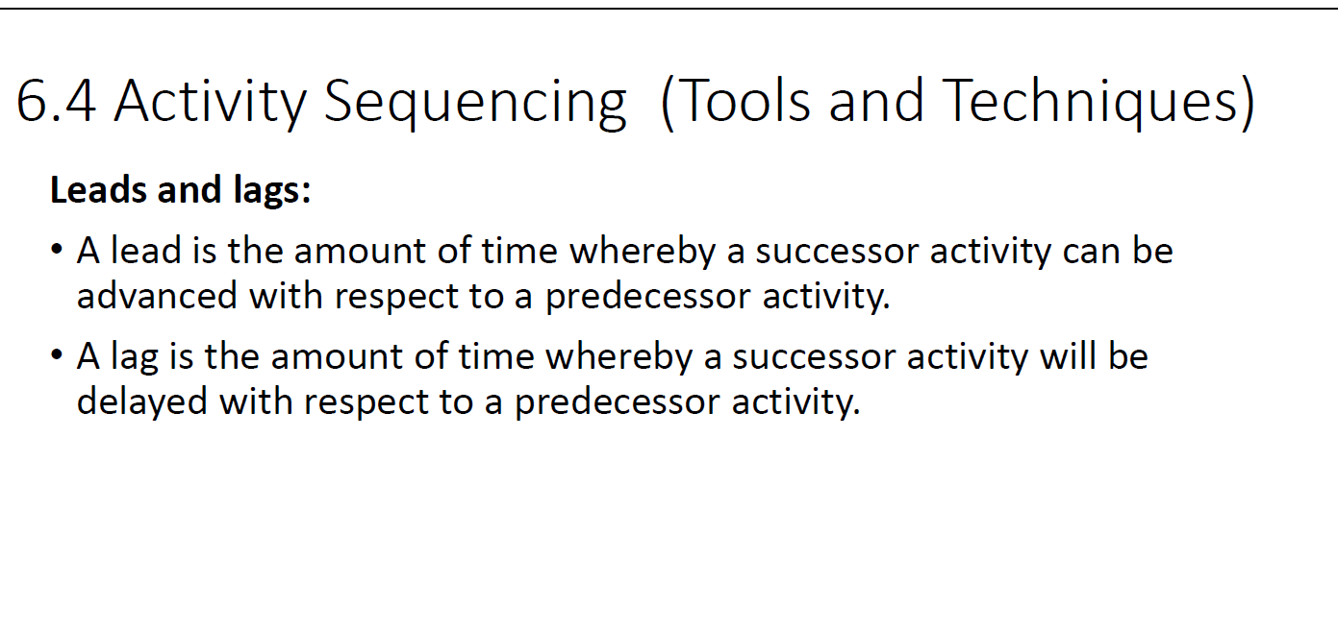

Slide 9
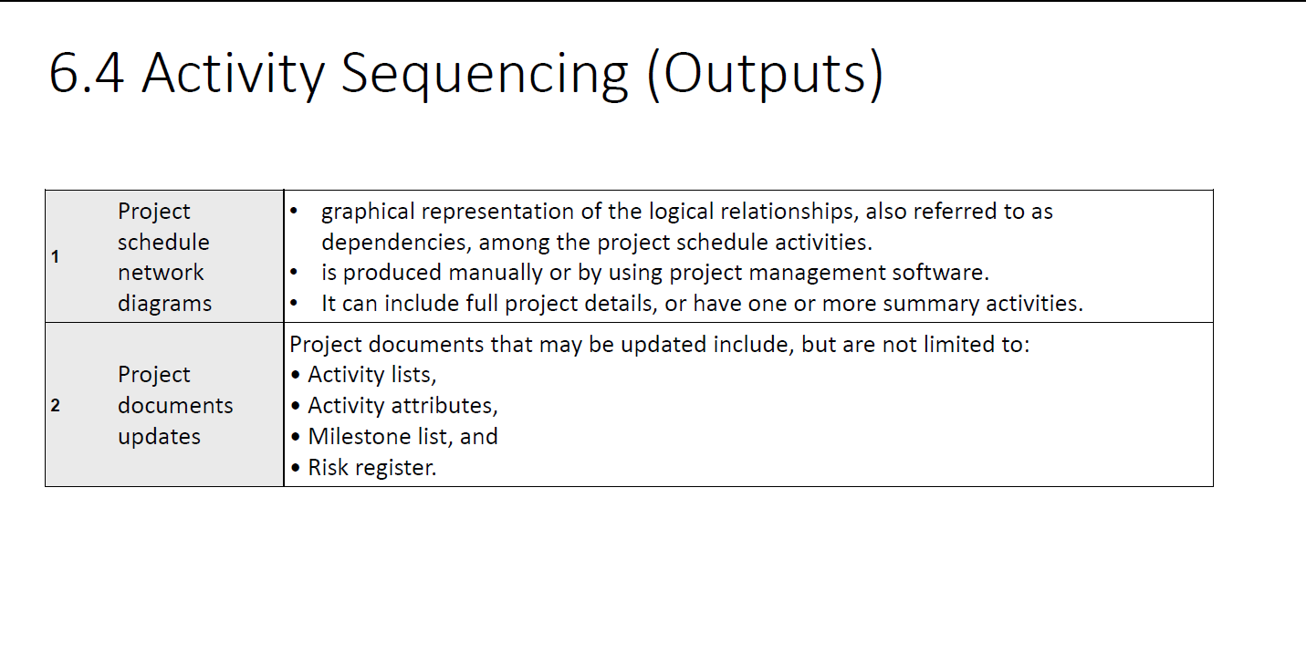

Slide 10
In project management, a network diagram is a visual representation of the sequence and interdependencies of project activities
It provides a graphical view of the project schedule, illustrating the flow and relationships between different tasks or activities.
Network diagrams are particularly useful for understanding the critical path of a project, identifying dependencies, and planning the most efficient schedule.
Components of a Network Diagram:
Nodes (or circles): Represent events or milestones in the project. These could be the start or finish of an activity.
Arrows (or lines): Represent activities or tasks. The arrows connect nodes to illustrate the sequence in which activities should be performed.
Duration Estimates: Associated with each arrow to represent the time it takes to complete a particular activity.
Dependencies: Indicate the relationships between different activities, showing which activities must be completed before others can start.
Critical Path: The longest path through the network, representing the minimum time required to complete the project. Activities on the critical path have no float or slack.

Slide 11
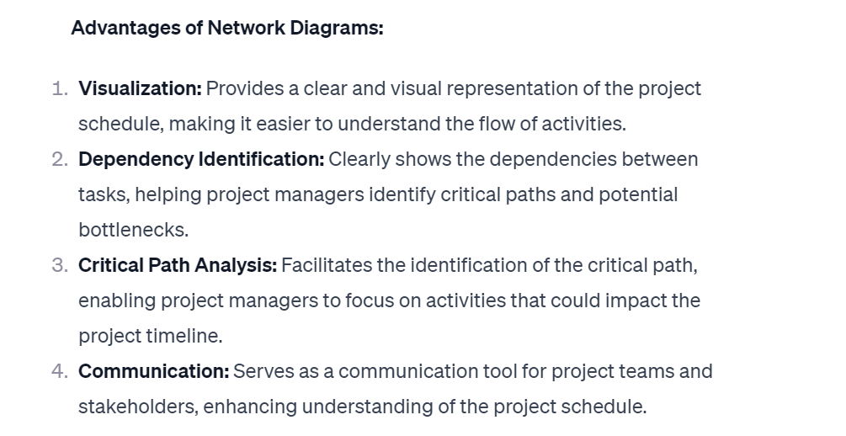

Slide 12
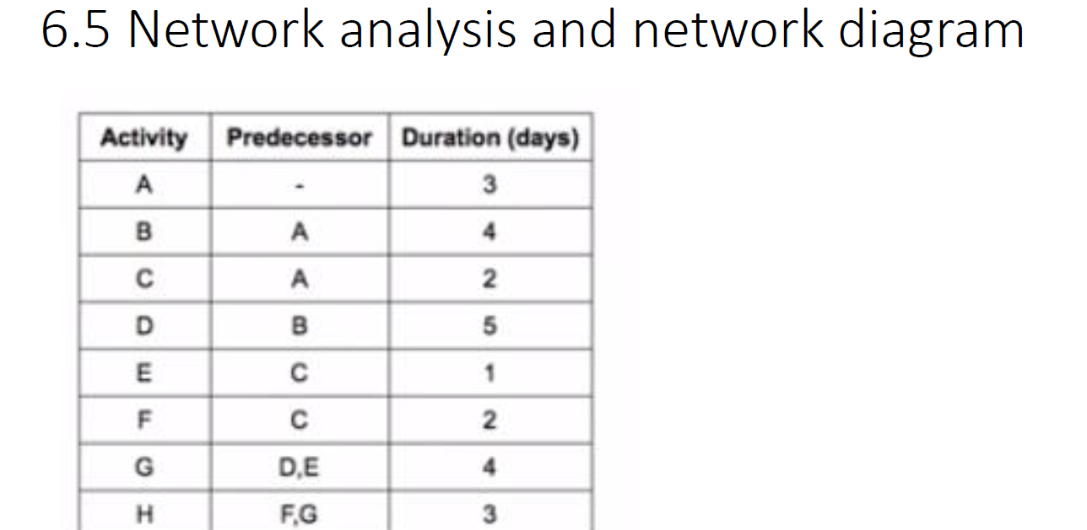

Slide 13
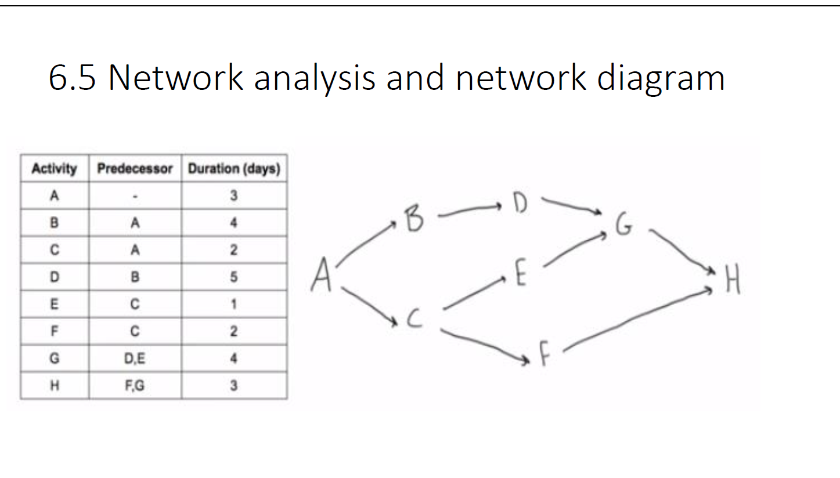

Slide 14
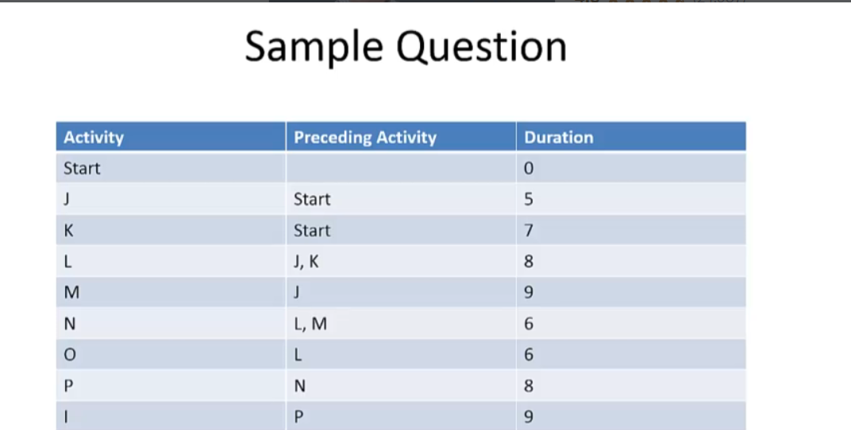

Slide 15
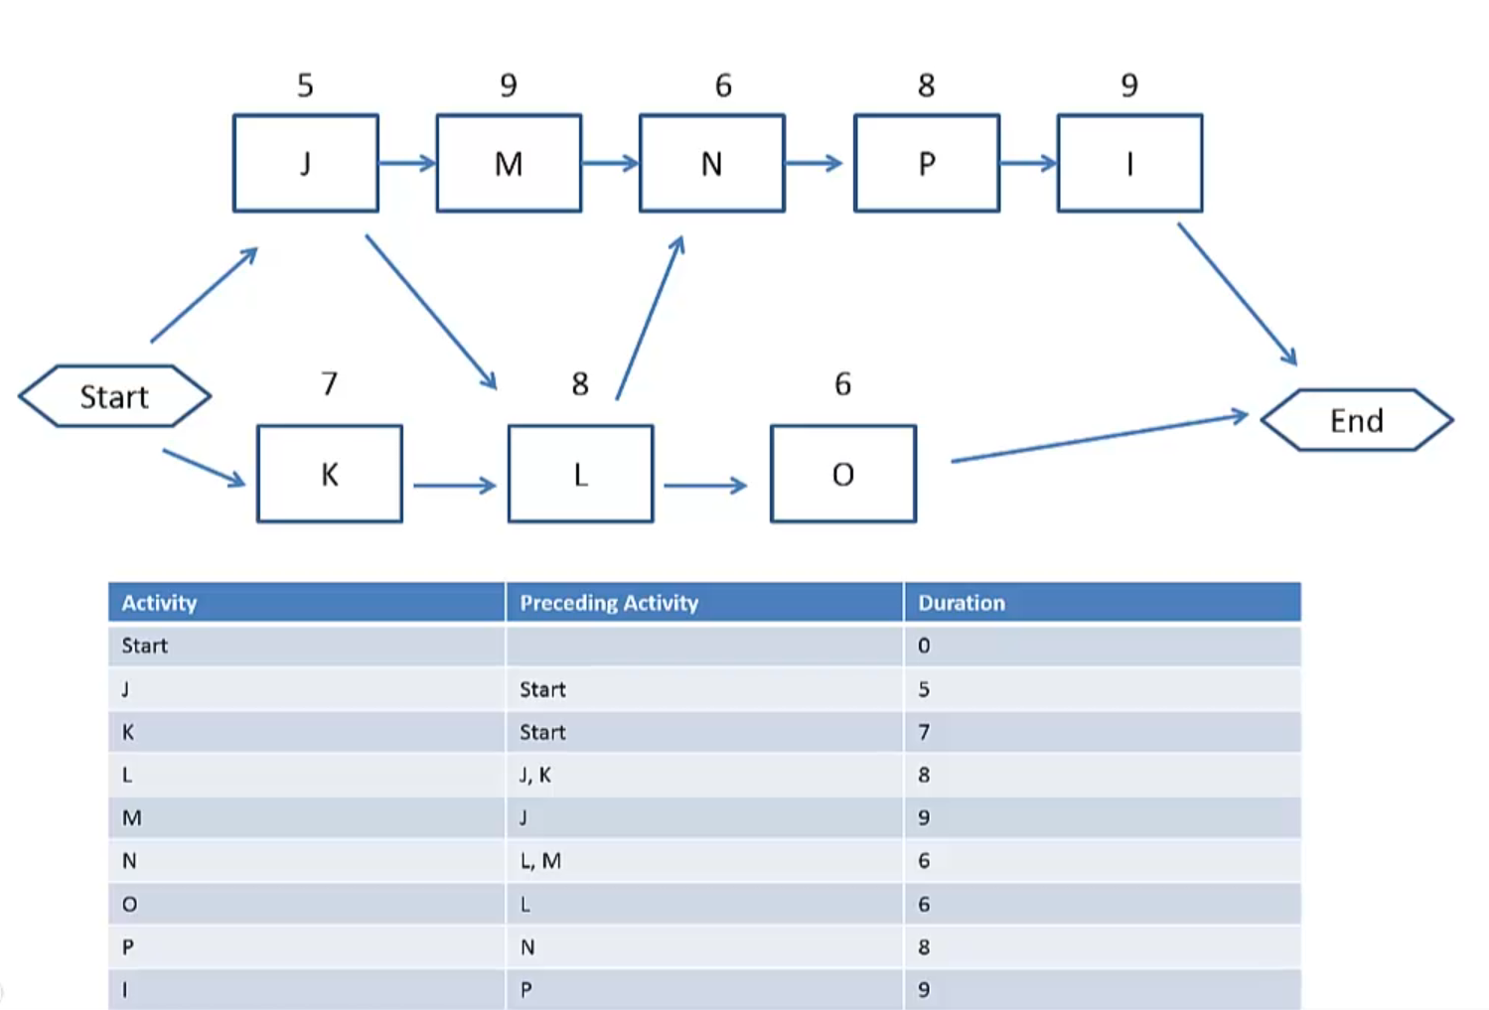

Slide 16


Slide 17
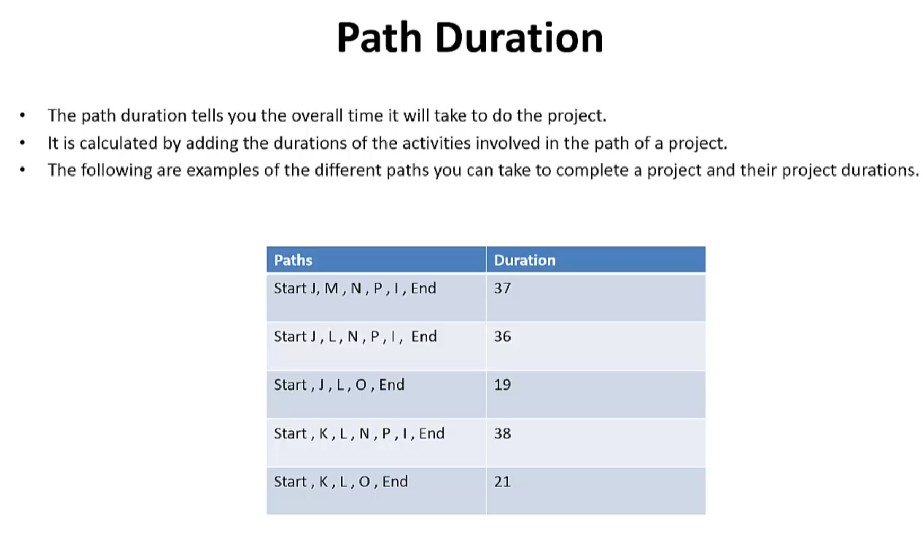

Slide 18
